Slide 1
BOOT CAMP REVIEW
Exponents
Perfect Square Roots
Perfect Cube Roots
Estimating Non-perfect Radicals
Scientific Notation

Slide 2
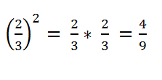
Exponents
The exponent of a number says how many times to use that number in multiplication.
All numbers can be multiplied, so all numbers can have exponents. Even fractions.

Slide 3
Exponents
2 x 2 x 2 is the same as 2³, since there are three 2's being multiplied together.
5 x 5 x 5 x 5 = 5⁴, because there are four 5's being multiplied together.

Slide 4
Multiplying the same base with exponents
When multiplying exponents…
if the bases are the same
KEEP THE BASE and add the exponents!!!

Slide 5
When dividing exponents…
if the bases are the same
KEEP THE BASE and subtract the exponents!!!
Negative exponents become positive in the denominator.
Positive exponents belong in the numerator.
Any number raised to the zero power equals 1.

Slide 6
Perfect Squares and Cubes, Not a Geometry Review

Slide 7
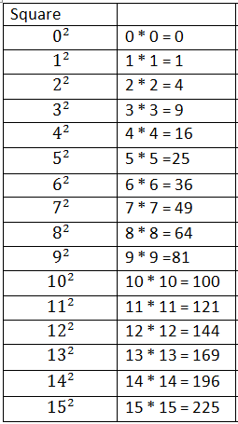
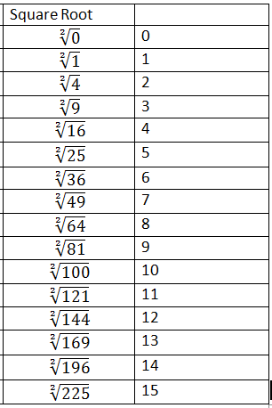
Squares The product of two identical factors

Slide 8
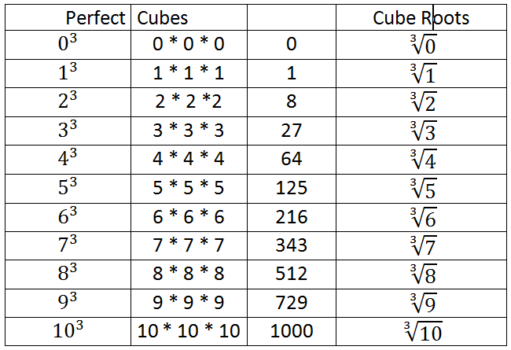
Cubes The product of three identical factors

Slide 9
Negatives
Negative squares
Negative Cubes
Multiplying two negatives equals a positive.
Multiplying three negatives equals a negative.
A negative times a negative equals a positive. A positive times a negative equals a negative.

Slide 10
Negative roots
When the negative is outside of the radical, it means that -1 is implied. Treat it as a multiplication problem.

Slide 11
Estimating Square Roots that are not perfect
Step 1: Decide which two (consecutive) perfect squares the number falls between. **The number line is your friend. Graph it!!**

Slide 12
Estimating square roots that are not perfect
Step 2: Calculate the differences between your number and the two perfect squares.
Step 3: Write this information as a ratio.
19 - 16 = 3
25 – 19 = 6

Slide 13
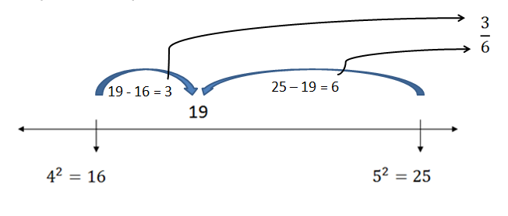
Estimating square roots that are not perfect
Step 4: Take the ratio and perform the division.
This will become a decimal that is to be added to the smaller of the two perfect squares.
0.5
6
3.0
-30
0

Slide 14
Estimating square roots that are not perfect
4.5
QUESTIONS??!!

Slide 15
Estimating Cube Roots
The number line is your friend. The solution will be a number between two whole numbers.
You need to be familiar with your cube root chart.

Slide 16
Estimating Cube Roots
On the number line, mark the two consecutive cube roots that fall on either side of your number.
79
So, the cube root of 79 falls between 4 and 5.

Slide 17
Scientific Notation
This is a way to express very large or very small numbers.
It is written as a natural number between 1 and 10 multiplied by 10 raised to a power.
Example:

Slide 18
Scientific Notation
The EXPONENT tells you how many places to move your decimal, and in which direction.
Just like a number line, a positive exponent moves the decimal to the right, a negative moves it left.
Negative direction: LEFT
Positive direction: RIGHT

Slide 19
Positive Exponent: Scientific Notation
Positive Exponent…move decimal to the right two places.
7.35 = 735

Slide 20
Negative Exponent: Scientific Notation
Negative exponent…move three decimal places to the LEFT.
6.589
Put zeros into the places made by moving the decimal.
.00658

Slide 21
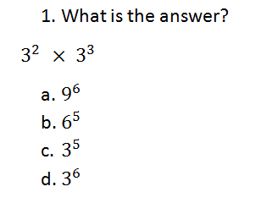
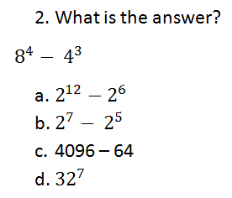
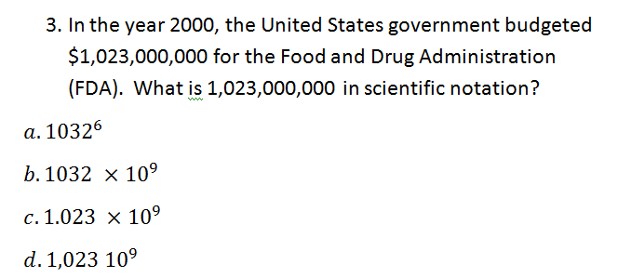
Answer the questions

Slide 22
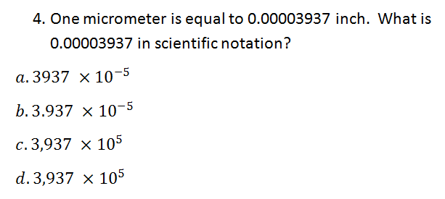
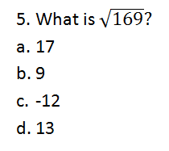
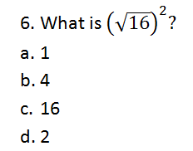
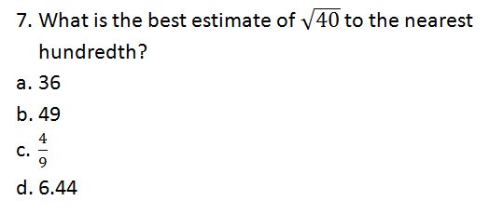
Answer the questions

Slide 23
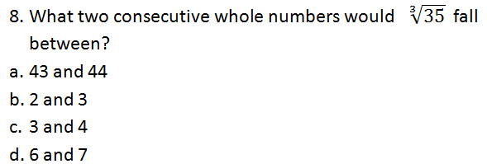
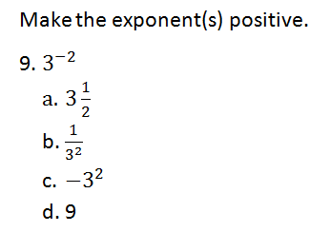
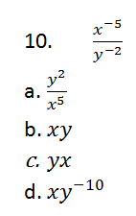
Answer the questions

Slide 24
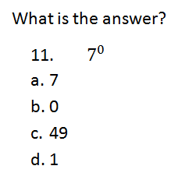
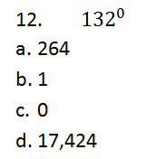
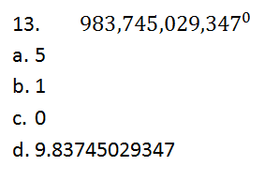
Answer the questions

