Slide 1
CCGPS Math 8
CRCT Boot Camp: Volume, Pythagorean Theorem, transformations, congruence and similarity, angle relationships

Slide 2
Types of Transformations
Translation-Sliding the figure
Rotation-Turning the figure
Reflection-Flipping or Mirroring the figure
Dilation-Magnifying or reducing the figure

Slide 3
Transformation Rules
Reflection over x-axis | (x,y) → (x, -y)
Reflection over y-axis | (x,y) →(-x, y)
Rotation 180º around the origin | (x,y) → (-x, -y)
Rotation 90º clockwise or 270 º counterclockwise around the origin | (x,y) → (y, -x)
Rotation 270º clockwise or 90 º counterclockwise around the origin | (x,y) → (-y, x)

Slide 4
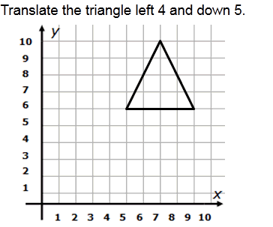
Example 1: Translation

Slide 5
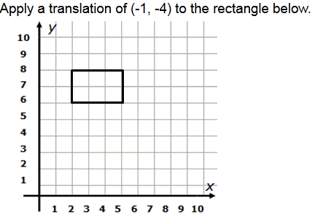
Example Two: Translations

Slide 6
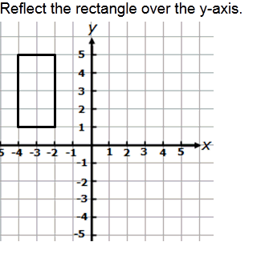
Example Three: Reflection

Slide 7
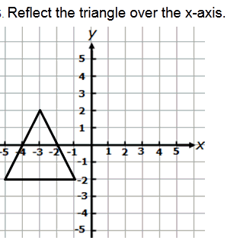
Example Four: Reflection

Slide 8
Example Five: Dilations
What are the coordinates when the figure is dilated by a scale factor of 4?

Slide 9
Example Six: Dilations
The original coordinates of a figure are
A(2,6); B(4, -8); C(12, 2) and D(16, 4).
What are the coordinates when the figure is dilated by a scale factor of ½?

Slide 10
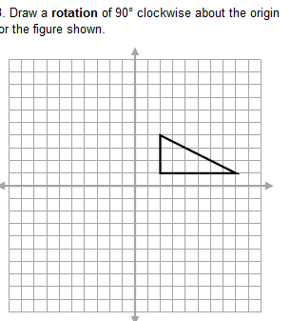
Example Seven: Rotation
What are the Coordinates after a rotation of 90 degrees clockwise?

Slide 11
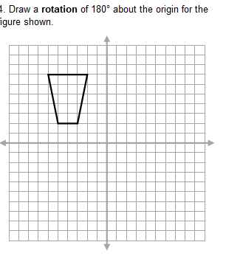
Example Eight: Rotation
What are the Coordinates after a rotation of 180 degrees?

Slide 12
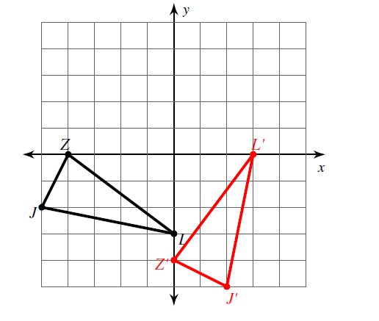
Example NiNe: What type of Transformation?

Slide 13
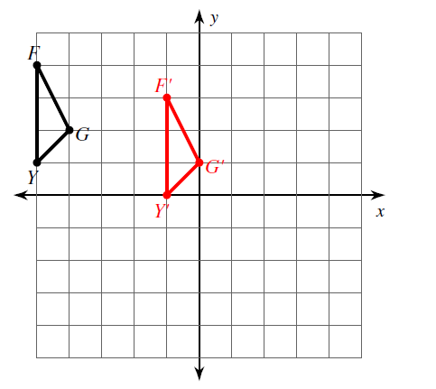
Example Ten: What type of transformation occurred?

Slide 14
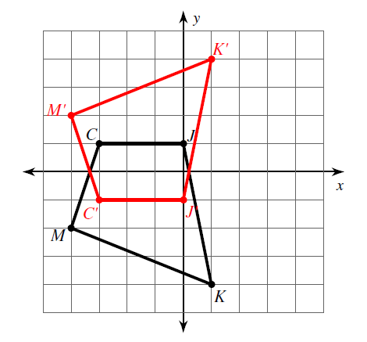
Example eleven: What type of transformation occurred?

Slide 15
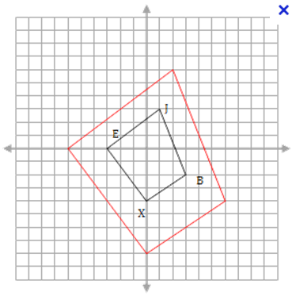
Example twelve: what type of transformation occurred?

Slide 16
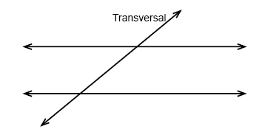
Angle relationships
Let’s Label: Same-Side Interior Alternate Interior Congruent Angles
Same-Side Exterior Alternate Exterior Supplementary Angles
Vertical Angles Corresponding Angles

Slide 17
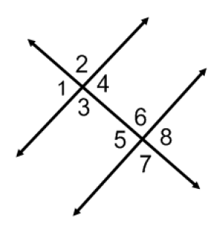
Example Thirteen: Angle Relationships
a) Name all pairs of alternate interior angles.
b) Name all pairs of corresponding angles.
c) Name all pairs of alternate exterior angles.
d) Name all linear pairs angles.
e) Name all vertical angles.
f) Name all consecutive (same-side) interior angles

Slide 18
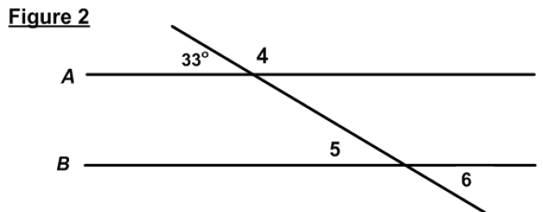
Example Fourteen: Applying Angle Relationships
Fill in Angles 4, 5 & 6.

Slide 19
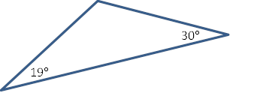
Example fifteen:
Triangles: Solving for missing angles.

Slide 20
Congruence and Similarity
What is the difference between similar figures and congruent figures?
*Similar figures have congruent corresponding angles and proportional corresponding sides.
*Congruent figures have congruent corresponding angles and congruent corresponding sides.

Slide 21
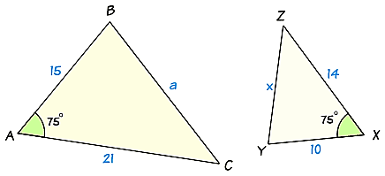
Example sixteen:
Are these triangles similar?
60º

Slide 22
Pythagorean Theorem
Explain the meaning of A²+B²=C² as it relates to right triangles.

Slide 23
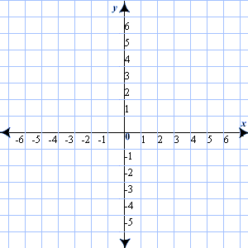
Example seventeen: Use pythagorean theorem to calculate the length of the line

Slide 24
Example eighteen: Pythagorean theorem
A youth soccer field is pictured below. A coach has his players run diagonally from one corner to the other. How far will they run?
5 yd

Slide 25
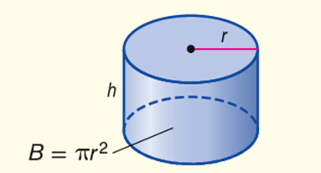

Example nineteen: volume
Find the exact volume of a cylinder:
height = 16 in. ; diameter = 12 in.
$$v=Bh$$

Slide 26
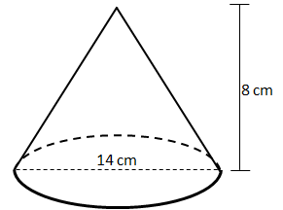

Example twenty: Volume
Find the exact volume of the cone in terms of pi:
$$v=\frac{1}{3}πr^{2}h$$

Slide 27
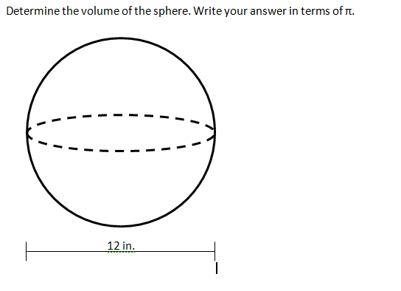

Example twenty-one: Volume
$$v=\frac{4}{3}πr^{3}$$

