Slide 1
Math Boot Camp
basic algebra, single variable equations,
functions vs. non-functions,
Linear vs. non-linear, linear functions, systems of equations

Slide 2
Solving Multi-Step Equations with one variable!
1. Clear fractions
2. Distribute
3. Combine like terms
4. Move all variables to one side
5. Solve
6. Check

Slide 3
Multi-Step Equations ~ Clearing Fractions
Clear fractions from an multi-step equation by finding the least common multiple (LCM)
In order to clear fractions from your equation, you will distribute the LCM of the denominators into every term in your equation.

Slide 4
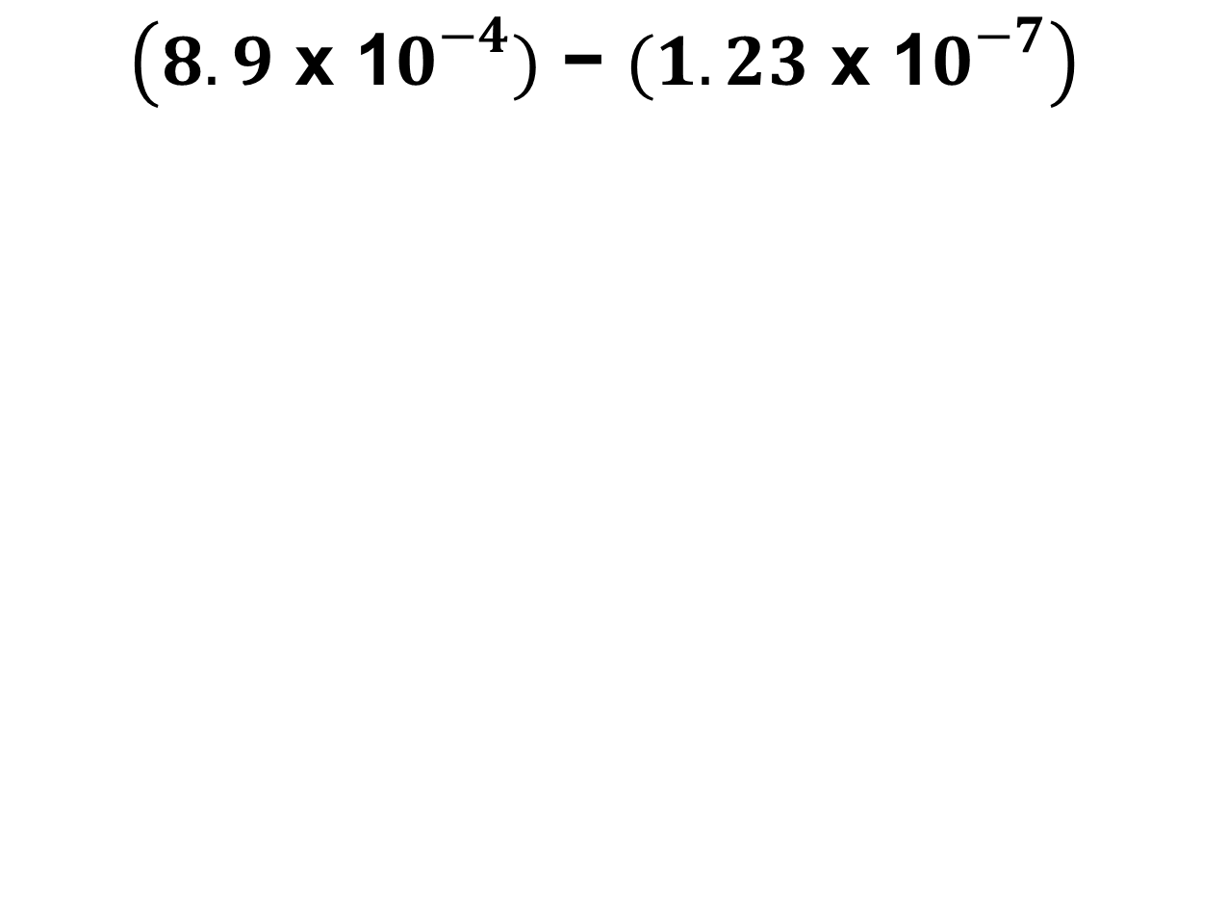
Questions
Topic: Multi-step equations with distribution
Page #
Date
$$3(x+6)=5x−2$$

Slide 5

Multi-Step Equations ~ Clearing Fractions
$$\frac{8}{3}x+\frac{3}{2}+\frac{2}{3}=−\frac{23}{6}$$

Slide 6

Multi-Step Equations ~ Clearing Fractions
$$m−\frac{8}{5}−\frac{2}{3}m=−\frac{7}{5}$$

Slide 7
Functions vs. Non-functions
relation
a correspondence between two sets
a relation is simply a set of ordered pairs.
WORDS TO KNOW
function
a relation in which every x-value has one y-value.

Slide 8
So what is a function?
The definition is that every input has only one output.
Let’s imagine that an INPUT is a person and
an OUTPUT is a place.
The rule is that every person can only go to one place at one time.

Slide 9
So how can we tell if a relation is also a function?
Imagine:
“every person can only go to one place at one time”

Slide 10
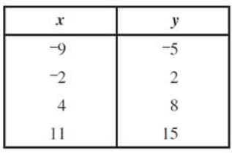
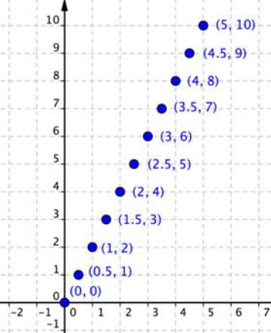
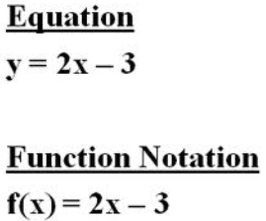
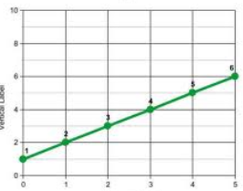
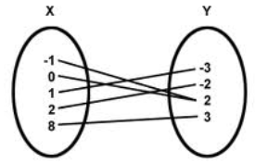
Different representations of relations and functions
Table
Table:
Ordered Pairs
Equations
Graphs
Mapping Diagram

Slide 11


Identify the functions…

Slide 12
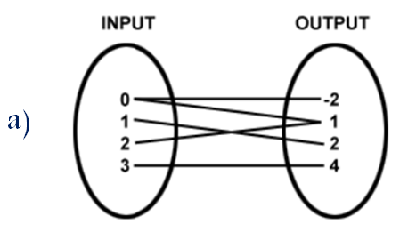
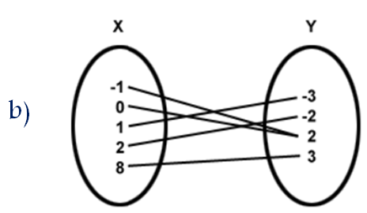
Identify the functions…

Slide 13
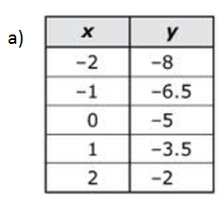
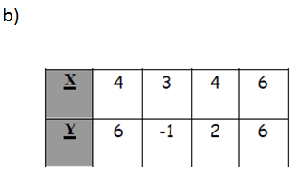
Identify the functions…

Slide 14
Functions vs. Nonfunctions:
The Vertical Line Test
Place a vertical line on the graph, if the line intersects the graph at only one points, the relation is a function. If the line intersects the graph at more that one point, the relation is not a function.

Slide 15
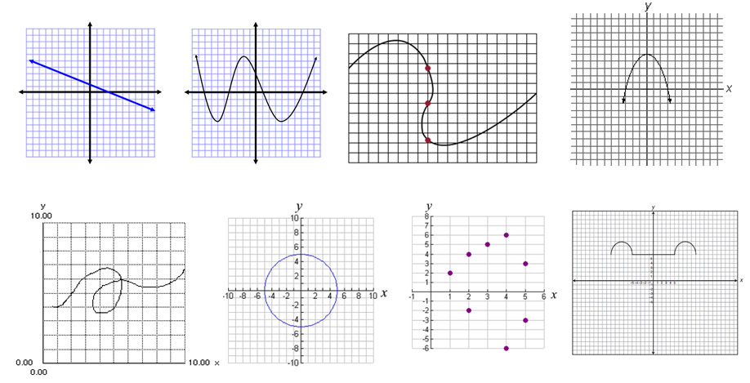
Use the vertical line test to determine which are functions and which are not!

Slide 16
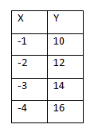
Multiple Representations of Functions.
Rewrite this table as a mapping diagram.

Slide 17
Multiple Representations of Functions.
Rewrite this set of ordered pairs as a mapping diagram.

Slide 18

Multiple Representations of Functions.
Rewrite this set of ordered pairs as a table.

Slide 19

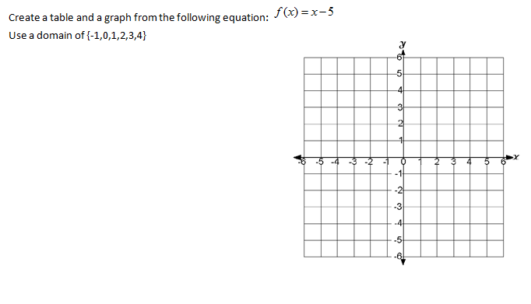
Multiple Representations of Functions.

Slide 20
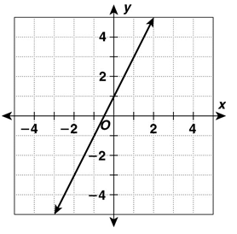
Multiple Representations of Functions.
Write a set of ordered pairs
and a table from this graph.

Slide 21
WORDS TO KNOW
Linear vs. Nonlinear Functions
linear equation
an equation in which variables represent real numbers and whose graph (visual representation) is a straight line
an equation which does not represent a linear sum of independent
components and whose graph is not a straight line
nonlinear equation

Slide 22
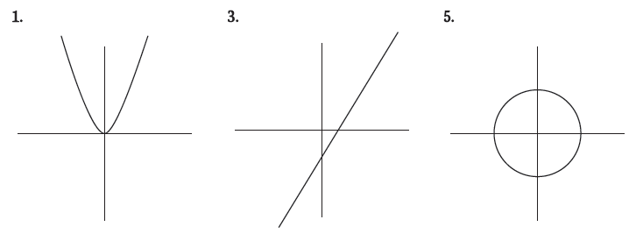
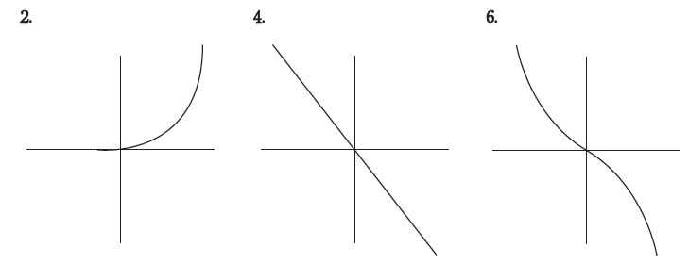
Linear vs. Nonlinear
Linear means “created by lines.” A linear equation is an equation that can be graphed by a line. A nonlinear equation is an equation that cannot be represented by a line. Determine whether the following graphs are linear or nonlinear.
non-linear
linear
non-linear
non-linear
linear
non-linear

Slide 23
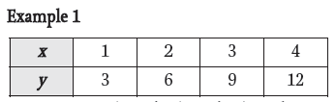
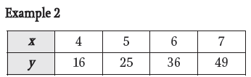
How do you determine if a relationship is linear when given a table?
How do you determine if a relationship is linear when given a table?
The difference between consecutive values of the dependent variable must be constant.

Slide 24
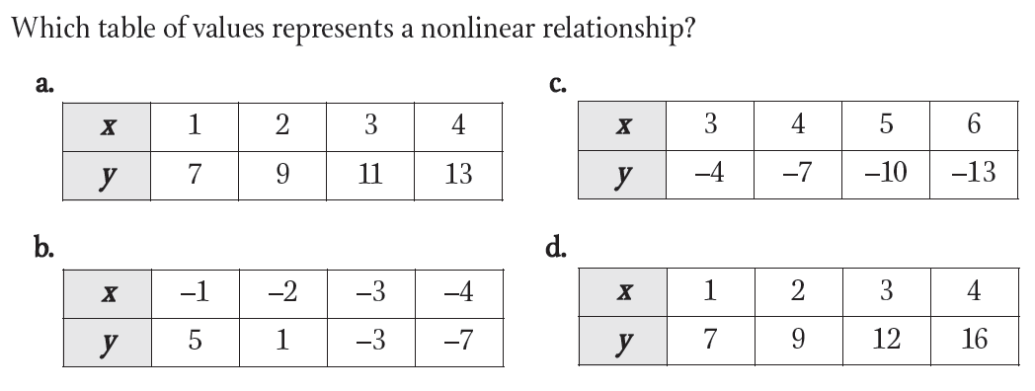
iRespond Question
Multiple Choice
F
296D63D4-A7F0-164F-B1B7-9F52CAE2A4AC
B.)
A.)
C.)
D.)
E.)

Slide 25
How can you determine if an equation is linear or nonlinear?
Ask the 3 questions…
Are any two variables being multiplied together?
Is there a power on any variable greater than 1?
Is there a variable in the denominator?

Slide 26
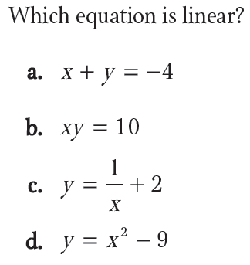
iRespond Question
Multiple Choice
F
94B50FD3-CE90-E04D-9240-4EEE105FC1E6
A.)
B.)
C.)
D.)
E.)

Slide 27
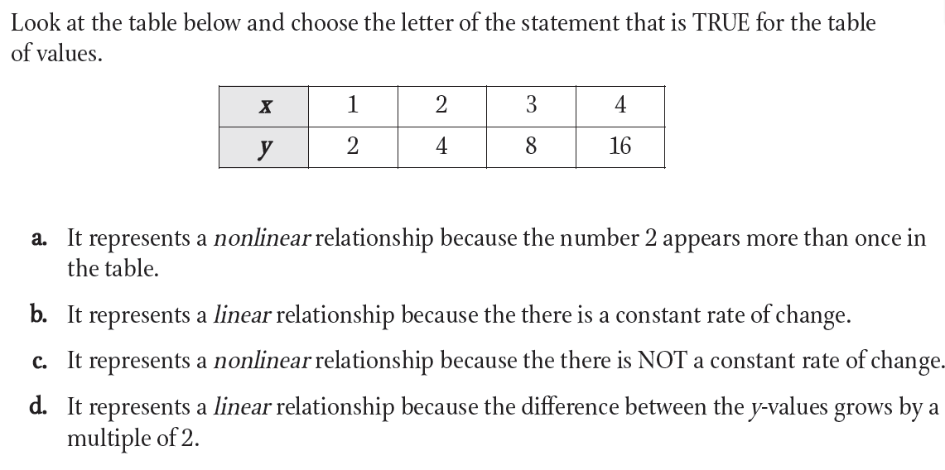
iRespond Question
Multiple Choice
F
576CD101-EB4F-3F4A-9E27-CB0E5B0366F6
A.)
B.)
C.)
D.)
E.)

Slide 28
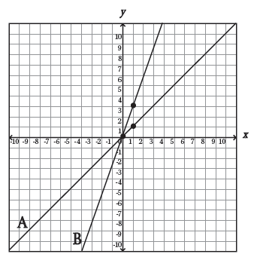
Which line is steeper?
Slope is the steepness of a line.
Slope is also known as the rate of change.
Slope is represented by the variable “m”

Slide 29

When one value changes,
another value changes proportionally.

Slide 30
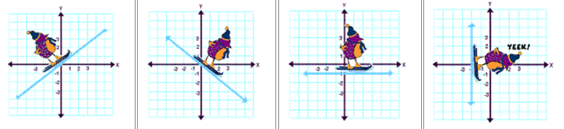
Review
There are 4 types of slope.
positive
negative
zero
undefined

Slide 31
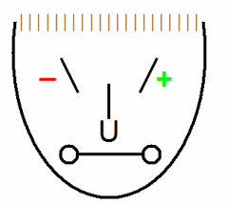
Reviewing Mr. Slope

Slide 32
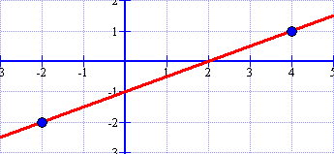
Counting Slope using Rise over Run
To find the slope of a line from a graph:
Plot or identify two lattice points
Count the RISE from the point on the left
Count the RUN to the point on the right
Write your slope as a fraction rise
run
Example

Slide 33
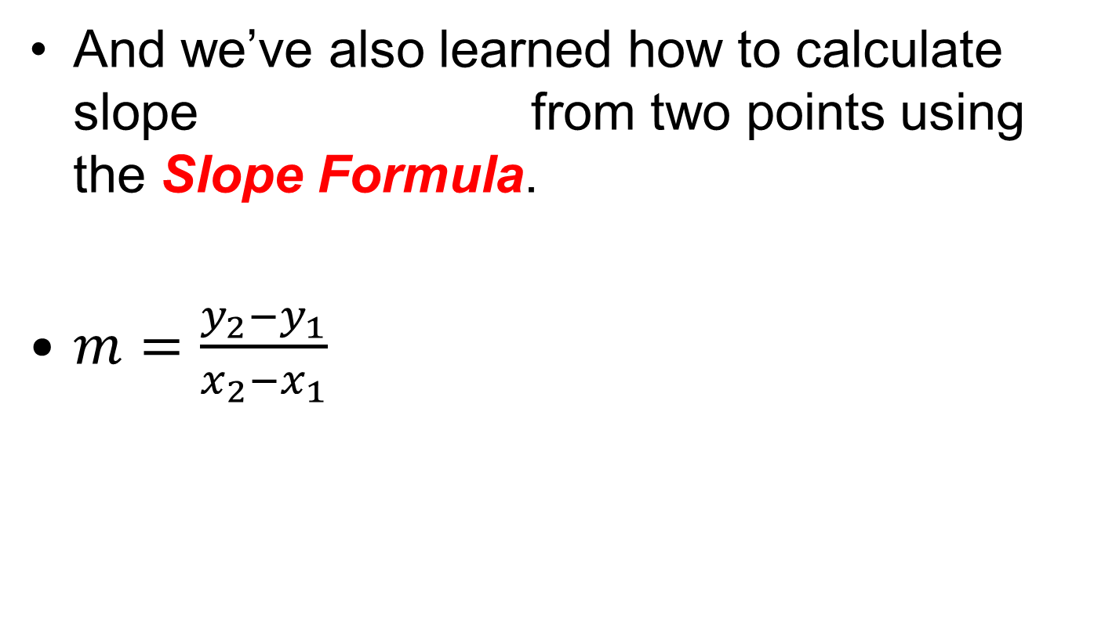
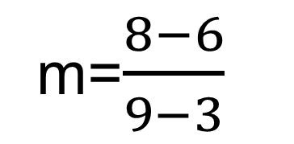
Graphing from Point and Slope
x₁
y₁
x₂
y₂
Steps:
Label Ordered Pairs
Substitute values into the slope formula
Solve
Simplify

Slide 34
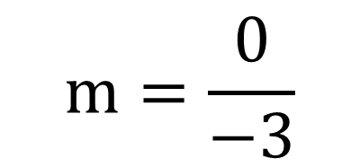
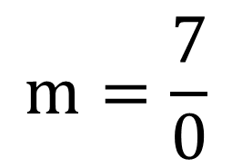
Very Important Information
Sometimes, your slope will look like this…
This is zero slope
or
This is an undefined slope

Slide 35
Slope Word Problems
In 2005, Joe planted a tree that was 3 feet tall. In 2010, the tree was 13 feet tall. Assuming the growth of the tree is linear, what was the rate of growth of the tree?
Remember, x is always years, so replace x2 with the second year and x1 with the first
y2 – y1
m =
x2 – x1
2010 – 2005

Slide 36
Slope Word Problems
In 2005, Joe planted a tree that was 3 feet tall. In 2010, the tree was 13 feet tall. Assuming the growth of the tree is linear, what was the rate of growth of the tree?
Replace y2 with the height from the second year and y1 with the first
y2 – y1
13 – 3
m =
2010 – 2005

Slide 37
Slope Word Problems
In 2005, Joe planted a tree that was 3 feet tall. In 2010, the tree was 13 feet tall. Assuming the growth of the tree is linear, what was the rate of growth of the tree?
The slope is 2, so the tree grows 2 feet per year
m = 2

Slide 38
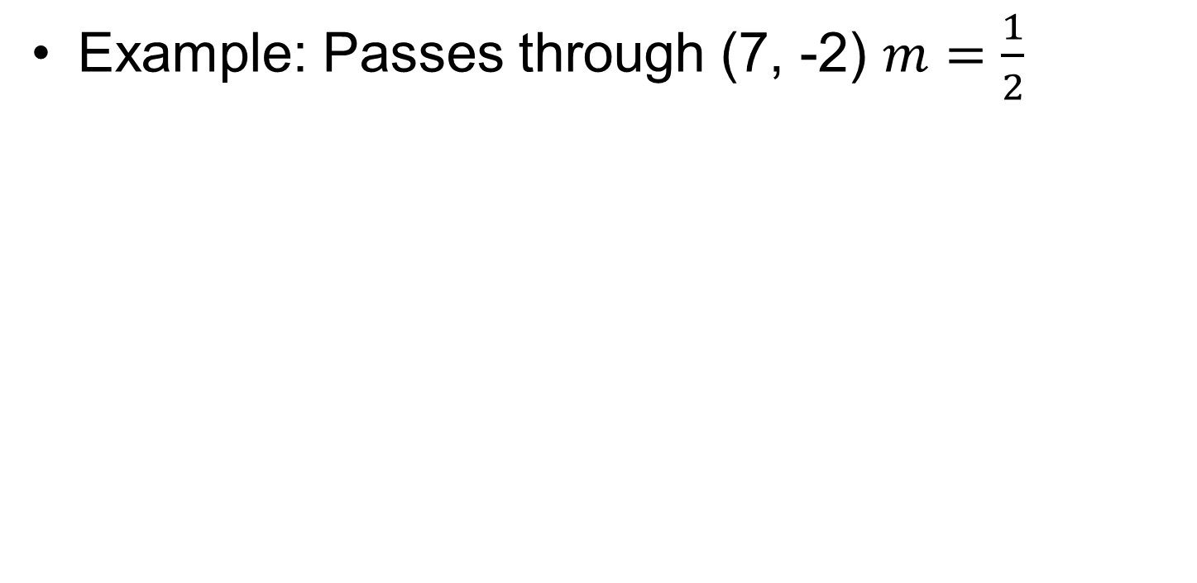
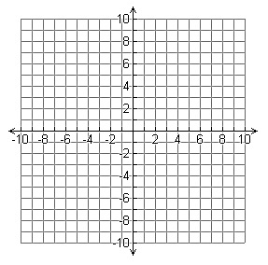
Graphing from Point and Slope

Slide 39
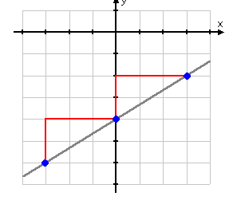
Slope and similar triangles

Slide 40
Words to Know
slope-intercept method
the method used to graph a linear equation using slope-intercept form,
draw a line using only two points on the coordinate plane.
slope
the steepness of a line expressed as a ratio, the rate of change, rise over run.
y-intercept
where the line crosses the y-axis
Slope

Slide 41
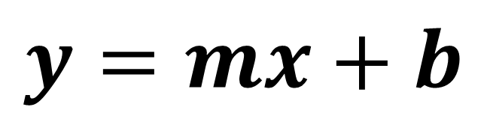
Graphing from Slope-Intercept Form
represent x and y coordinates
slope
y-intercept
“b” for begin
Slope

Slide 42
Graphing from Slope-Intercept Form
Steps:
Identify the y-intercept and the slope
Plot the y-intercept on the y-axis
From the y-intercept, count the slope using rise over run
Repeat until you have made as many points as possible
Draw the line (arrows) with a straightedge
Slope

Slide 43
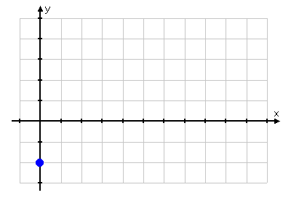
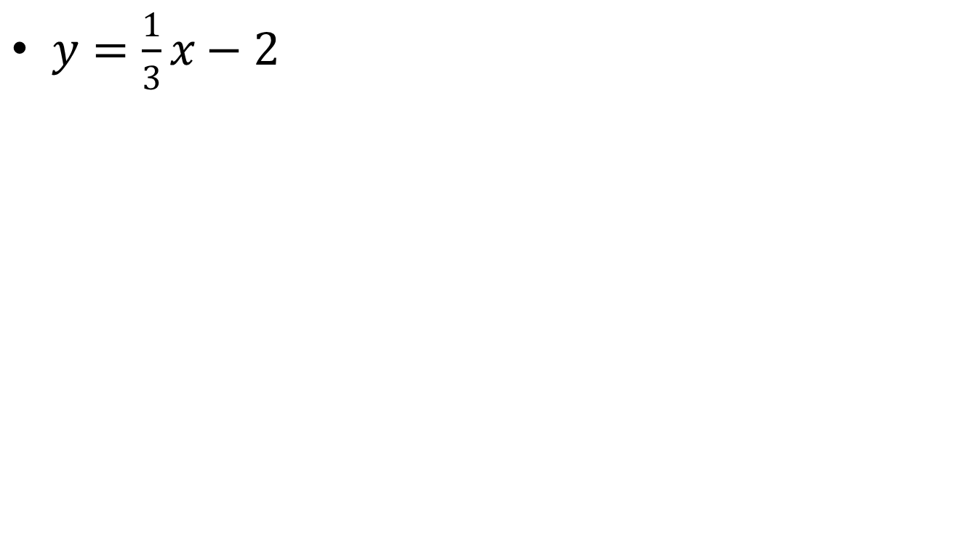
$y=\frac{1}{3}x−2$

Slide 44
Converting equations
When equations are in standard form (Ax + By = C), then you need to change them into slope-intercept form (y = mx + b)

Slide 45
Converting equations

Slide 46
How to write equations from graphs
Identify the y-intercept
2) Find 2 lattice points and count the slope using rise over run
3) Write the equation in slope-intercept form using the found slope
and the y-intercept

Slide 47
y
8
7
6
5
4
3
2
1
x
–7 –6 –5 –4 –3 –2 –1
1 2 3 4 5 6 7 8
⁻1
⁻2
⁻3
⁻4
⁻5
⁻6

Slide 48
How to write an equation from a point and slope
Substitute the slope (m) and the point (x, y) into slope-intercept form (y = mx + b)
2) Solve the equation for b
3) Write a new equation in slope-intercept form using the
given slope and the new y-intercept (b)

Slide 49
Example 1
Write the equation of a line that passes through the point (-1, -6) with a slope of 4.

Slide 50
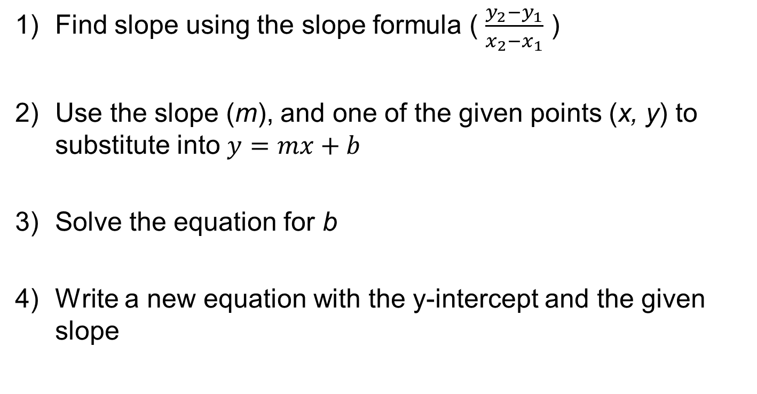
How to write an equation from two points

Slide 51
Example 1
Write the equation of the line which passes through the points (3, 4) and (4, 6)

Slide 52
Slope-Intercept Form
Word problems with linear equations will be in slope-intercept form if you are given the following information:
the slope (m) - the rate of change
the y-intercept (b) - the starting (initial) value

Slide 53
Define your variables.
*Let x=the independent variable
*Let y=the dependent variable

Slide 54
To Write the equation:
y=mx+b
Determine the rate of change and insert it in as m.
Determine the initial value as insert it as b.

Slide 55
Use the equation:
*Substitute the known variable into the equation, and solve for the unknown.

Slide 56
Example:
Papa John’s charges $8 for a large pizza plus $0.50 per topping. Write an equation to model the cost, y, for a pizza with x number of toppings. Then use the equation to calculate the cost of a large pizza with 5 extra toppings (without tax).
Let x = Equation:_________________________
Let y=

Slide 57
Standard Form
Ax + By = C
You will write an equation in standard form if you are given the following information:
Values for two types of items
The values are combined to equal one total.
There’s either no rate of change or two rates of change.

Slide 58
How to write standard form equations from word problems
Step 1: Write “Let” statements. It does not matter which is X or Y.
Step 2: Write the equation in the form of Ax+By=C. Make sure to assign the coefficients to the correct variables.
Step 3: Substitute in the known variable and solve for the unknown variable.
Step 4: State your answer in sentence form.

Slide 59
Example
The school sells pens for $2.00 and notebooks for $3.00. The equation 2x + 3y = 60 describes the number of pens x and notebooks y that you can buy for $60. How many notebooks did you buy if you got 15 pens?

Slide 60
Graphs Tell a Story
Using the information we know about slope- increasing, positive, decreasing, negative, constant, rate of change, etc we can create stories to match a graph.

Slide 61
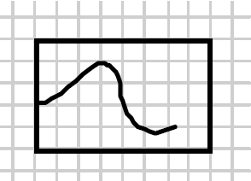
The graph represents a person’s skin temperature as he enters a sauna and
then cools off in a jacuzzi?

Slide 62
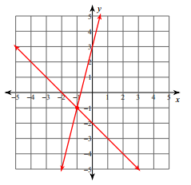
Systems of Equations
For Example: y=4x+3 y=-x-2
What is an intersection?
When graphed, the two equations look like this:
What is the solution to a System of Equations?
*(-1, -1) is the point of intersection for these two equations.
*The point where the equations intersect, is called their solution.

Slide 63
Solving Systems of Equations by graphing.
You will be given two linear equations.
Be sure they are both in slope intercept form (y=mx+b).
  A) If any of the equations are in standard form (Ax+By=C), convert them into slope intercept form.
Graph the lines using their y-intercepts and slopes.
Find the ordered pair where the two lines intersect.
Write the ordered pair as the solution.
Check the solution by substituting the X and Y values from the ordered pairs into the equations.

Slide 64
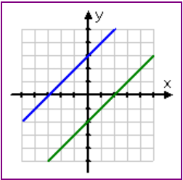
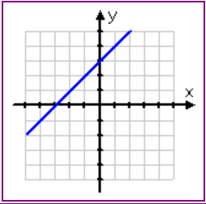
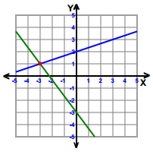
Types of Solutions
Equations with… the same slope are parallel. There is no solution. They do not cross. | Equations with… the same slope AND y-intercept are the same line. There are infinite solutions. | Equations with… different slopes AND different y-intercepts that intersect in a single point have one solution.

Slide 65
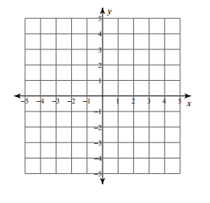
Example One:
y = 2x – 1 y = -x + 5
m=_____ m=_____
b=_____ b=_____
Solution is (2,3)
Check the solution by substituting the x and the y into both equations to see if the statements are true.
y = 2x - 1
3 = 2(2) – 1
3 = 4 – 1
3 = 3
YES!
y = -x + 5
3 = - (2) + 5
3 = 3
YES!

Slide 66

Check it out…
Example
Step One: Put both equations into slope-intercept form (y=mx+b) | Step Two: With both equations in slope-intercept form, set them equal to one another and solve for x. | Step Three: Substitute the found value of x into one of the equations and solve for y.
 |  | Step Four: Check your answer.

Slide 67
Solving a system of equations by elimination using addition and subtraction.
Step 1: Put the equations in Standard Form.
Standard Form: Ax + By = C
Step 2: Determine which variable to eliminate.
Look for variables that have the
same coefficient.
Step 3: Add or subtract the equations.
Solve for the variable.
Step 4: Substitute back in to find the other variable.
Substitute the value of the variable
into the equation.
Step 5: Check your solution.
Substitute your ordered pair into
BOTH equations.

Slide 68
Solve using elimination.
2x – 3y = -2
x + 3y = 17
(5, 4)

Slide 69
Solving a system of equations by elimination using multiplication.
Step 1: Put the equations in Standard Form.
Standard Form: Ax + By = C
Step 2: Determine which variable to eliminate.
Look for variables that have the
same coefficient.
Step 3: Multiply the equations and solve.
Solve for the variable.
Step 4: Substitute back in to find the other variable.
Substitute the value of the variable
into the equation.
Step 5: Check your solution.
Substitute your ordered pair into
BOTH equations.

Slide 70
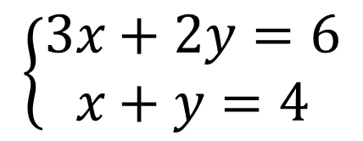
Solve using elimination.
2x – 3y = 1
x + 2y = -3
(-1, -1) (-2,6)

Slide 71
A system of equations is a set of two or more equations that have variables in common.
The common variables relate to similar quantities. You can think of an equation as a condition imposed on one or more variables, and a system as several conditions imposed simultaneously.
Remember, when solving systems of equations, you are looking for a solution that makes each equation true.

Slide 72

Suppose your community center sells a total of 292 tickets for a basketball game. An adult ticket cost $3. A student ticket cost $1. The sponsors collected $470 in ticket sales. Write and solve a system to find the number of each type of ticket sold.

Slide 73
Extended Response
Types
  Process
  Problem Solving
  Proof

Slide 74
Extended Response
Use the CLEVER method
  Claim or Conjecture = topic sentence
  Evidence= details to support, steps of the process, etc
  Examples/counterexample
  Reasoning – properties, theorems, etc.

Slide 75
Extended Response Examples
Explain the process of solving the following equation
Draw, label and explain a proof of the Pythagorean Theorem
Any problem solving like the POW’s

Slide 76
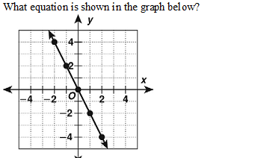
Practice 1

Slide 77

Practice 2

Slide 78

Practice 3

Slide 79

Practice 4

Slide 80
Practice 5
What is the equation of the line that passes through the point (-2,5) and (1,1)?

Slide 81
Practice 6
What is the slope of the lines that passes through the points (-2,-5) and (1,4)?

Slide 82
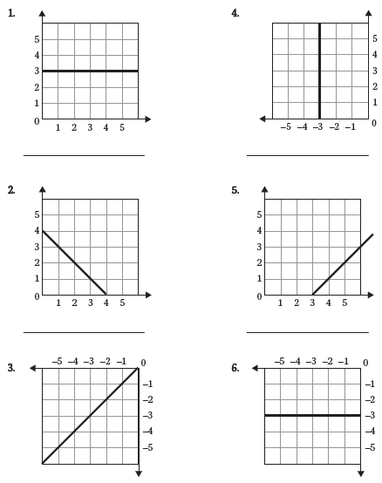
ractice 7 ify the type of slope

Slide 83
Practice 8
What is the y-intercept of the line represented by

Slide 84

Practice 9
Solve the system

Slide 85
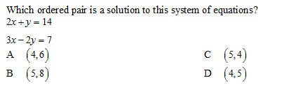
Practice 10

Slide 86
Practice 11
What is the slope-intercept form of
the line passing through the point
(2, 1) and having slope of 4?

Slide 87

Practice 12
Which of the following situations
corresponds to this graph?
A A bicyclist accelerates from a stop, travels at a constant speed, then slows to a stop.
B A car accelerates from a stop,
travels at a constant speed, slows,
and then travels at a slower speed.

Slide 88
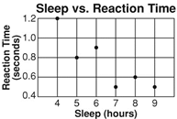
Practice 13
What is true about the data displayed in the scatter plot: there is a positive correlation, a negative correlation, or no correlation?

Slide 89
Practice 14
What is the solution to the system graphed below?

Slide 90
Practice 15
The sum of two numbers is 21. The difference of the two numbers is 13. What are the two numbers?
A) (5,16) C) (7,14)
B) (9,12) D) (17,4)

Slide 91
Practice 16
Solve the system:
x + y = –3
x – y = –5
A (4, 2) C (–4, 1)
B (–5, 2) D (–5, 4)

