Slide 1
Milestone review
Unit 5: Linear Functions & Slope Intercept

Slide 2
$$Write the equation$$ $−4x+3y=−2$ $in slope intercept form.$
Identify the slope and the y-intercept.
1

Slide 3
Use the point-slope form of the equation of line y – 8 = $\frac{7}{3}$(x – 3) to identify a point the line passes through and the slope of the line.
Hint:
* How does this equation look like the point-slope formula?
* What do you need to use the point-slope formula?
2

Slide 4
A linear equation has the same y-intercept as -x + 5y = 10 and its graph contains the point (10,4). Find the y-intercept and the slope of the linear equation.
3

Slide 5
What is the equation of the line that passes through (7,4) and (4,8) in slope-intercept form.
Hint:
* What 2 formulas could you use to solve this problem?
4

Slide 6
What is the point-slope form of the line of the equation of the line with slope $\frac{2}{3}$ that passes through the point (2,-9).
y – 9 = $\frac{2}{3}$(x+2) c. y + 9 = $\frac{2}{3}$ (x-2)
y + 2 = $\frac{2}{3}$ (x-9) d. x – 2 = $\frac{2}{3}$ (y+9)
5

Slide 7
Data is collected on the shoe size and the height of a random group of students. Identify the correlation you would expect to see between the shoe size and the height.
6

Slide 8
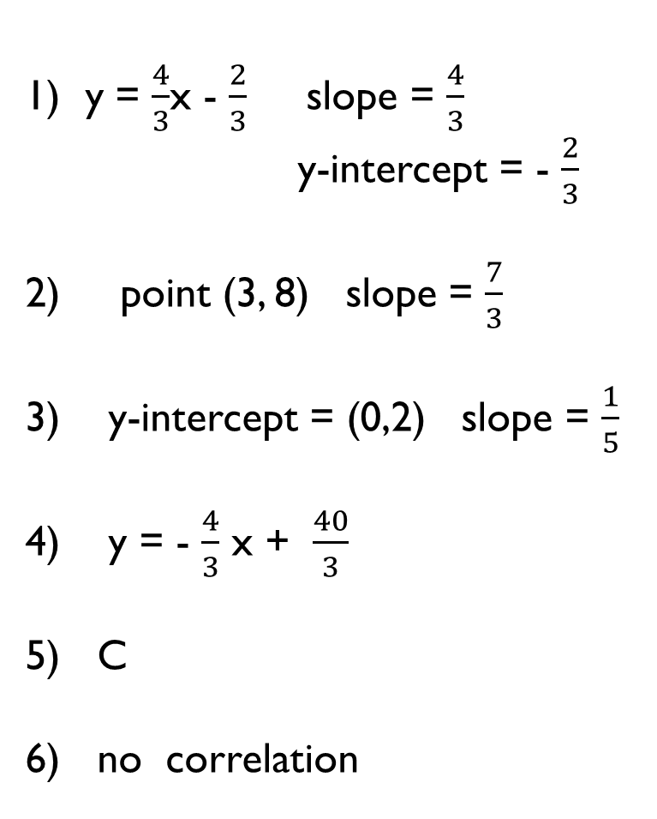
y = $\frac{4}{3}$x - $\frac{2}{3}$ slope = $\frac{4}{3}$ y-intercept = - $\frac{2}{3}$
point (3, 8) slope = $\frac{7}{3}$
y-intercept = (0,2) slope = $\frac{1}{5}$
y = - $\frac{4}{3}$ x + $\frac{40}{3}$
C
no correlation
7)
8)
9)
10)
11)
12)

Slide 9
7

Slide 10
8

Slide 11
9

Slide 12
10

Slide 13
11

Slide 14
12

Slide 15
13

Slide 16
14

Slide 17
15

Slide 18
16

Slide 19
17

Slide 20
18

Slide 21
19

Slide 22
20

