Slide 1
Milestone review
Unit 7: Systems of Equations

Slide 2
What type(s) of solutions can a system of equations have?
1

Slide 3
How many solutions does the system of equations have?
3x + y = 5
y = x + 5
2

Slide 4
What does the graph look like for the following system of equations?
Y = 2x – 4
Y = 2x + 1
3

Slide 5
What is the solution of the following system of equations ?
y = $−\frac{1}{3}$ x + 5
y = 2x - 2
4

Slide 6

Is the given point the solution of the system of equations?
4x - y = 2
-3x + y = 0
$$(2,6)$$
5

Slide 7
What is the best way to solve the following systems of equations?
(graphing, substitution, elimination)
-12x + 3y = -9
12x - y = -3
6

Slide 8
Solve the system of equations.
Write the answer as an ordered pair.
4x + 3y = 4
-2x + 2y = 12
7

Slide 9
What are the possible solutions for a system of equations?
a. One solution or no solution
b. One solution, no solution, or infinitely many solutions
c. Linear, collinear or nonlinear
d. Graphing, substitution, or elimination
8

Slide 10
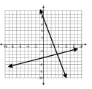
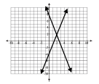
Which graph should be used to determine the solution of the system of equations: −3𝑥 + 𝑦 = −4 𝑦 = −3𝑥 + 8
a. b.
9

Slide 11
If (3,𝑦) is the solution to this system of equations, determine the value of 𝑦.
2𝑥 − 3𝑦 = 0
2𝑥 + 𝑦 = 8
a. 2 c. 5
b. 3 d. 6
10

Slide 12
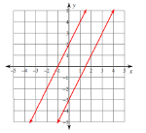
What is the solution of the linear system below?
11

Slide 13
Solve the system of equations using substitution.
𝑥 + 𝑦 = 9
𝑦 = 13 − 2𝑥
12

Slide 14
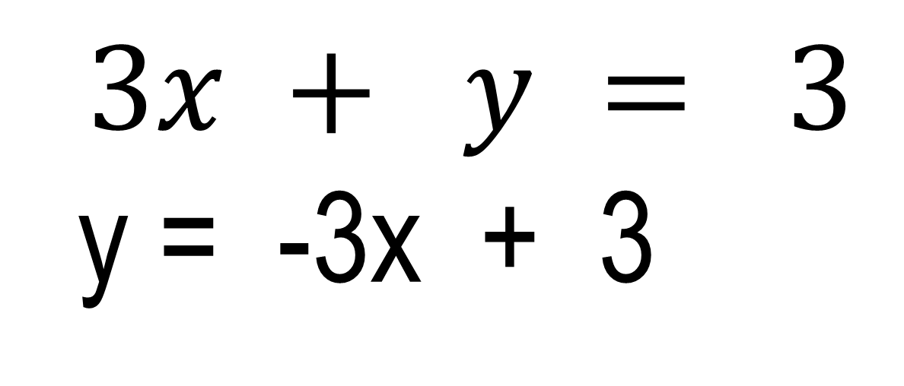
How many solutions does the following system of equations have?
$$3x + y = 3$$
y = -3x + 3
13

Slide 15
Five baseballs and three footballs cost $88. The cost of two baseballs and seven footballs is $186. . Write a system of equations that could be used to find the cost of one baseball, b, and one football, f?
14

Slide 16
Explain why there is no solution to the system 𝑥+2𝑦=5
𝑥+2𝑦=8 a. The lines are collinear so there is no solution.
b. The lines are parallel so there is no solution.
c. The lines intersect at one point so there is no solution.
15

Slide 17
You have been given two job offers – job A and job B as shown in the table below. After how many years is the salary equal?
a. 20 years
b. 10 years
c. 5 years
d. 4 years
16

Slide 18
What is true of the graphs of the two equations? 𝑦 = −$\frac{1}{2}$𝑥 + 2
3𝑥 + 2𝑦 = 8
a. The lines intersect in exactly one point, (2, 1)
b. The lines intersect in exactly one point, (0, 2)
c. The lines are parallel.
d. The lines are collinear.
17

Slide 19
Write the solution to the system of equations as an ordered pair.
y = -2x – 4
y = x + 8
18

Slide 20

Is the given point the solution of the system of equations?
x - y = -12
2x + y = 2
$$(−5,7)$$
19

Slide 21
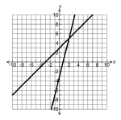
What is the system of equations represented by the graph below?
𝑥=1 𝑦=3
b. 𝑦=3𝑥+1 𝑦=−3𝑥+4
c. 𝑦=𝑥+3 𝑦=4𝑥−3
20

Slide 22
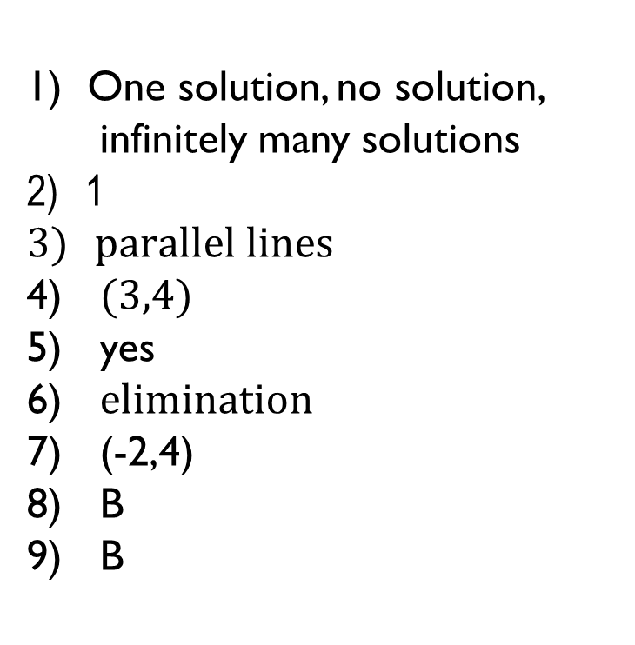
One solution, no solution, infinitely many solutions
1
$parallel lines$
$(3,4)$
yes
$elimination$
(-2,4)
B
B
10) A
11) no solution
12) (4, 5)
infinitely many solutions
5b + 3f = 88 2b + 7f = 186
B
A
A
(-4,4)
no
C

